Slide 1
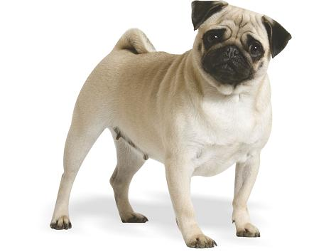

Slide 2
ASO

Slide 3
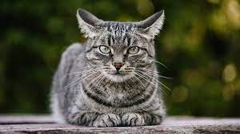

Slide 4
Pusa

Slide 5
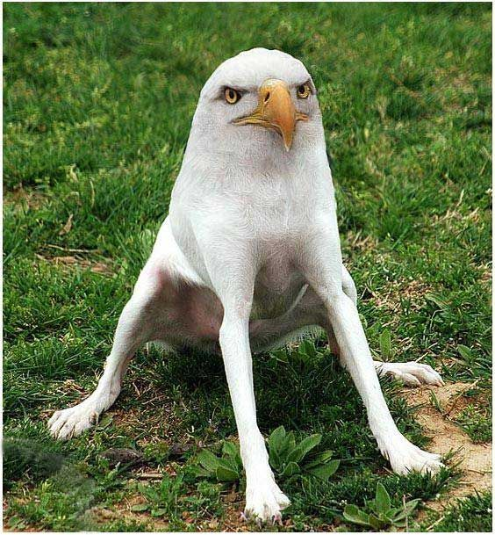

Slide 6
E
A
G
L
E
A
G
I
L
A

Slide 7
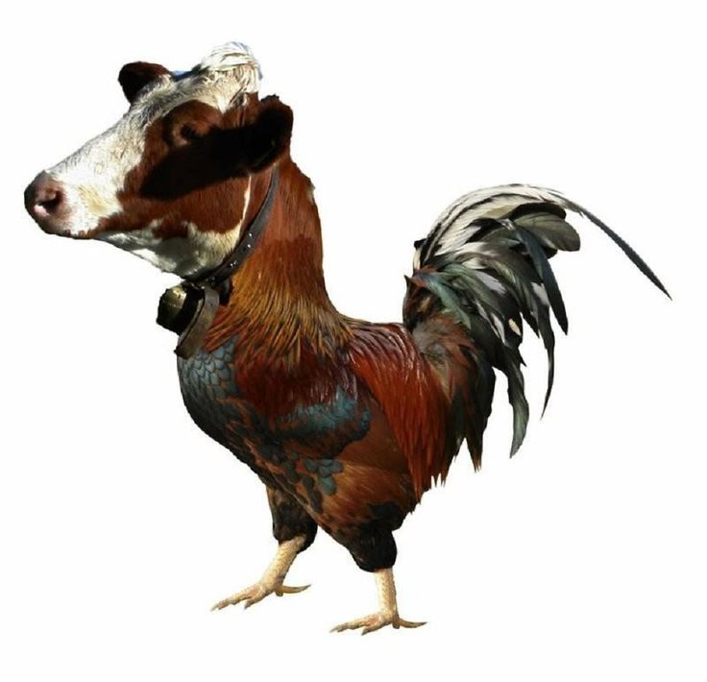

Slide 8
BAKA

Slide 9
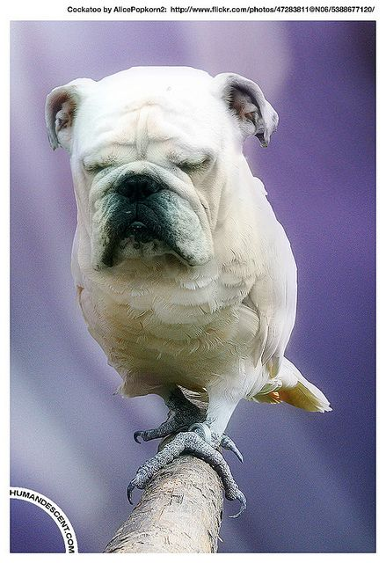

Slide 10
ASO

Slide 11
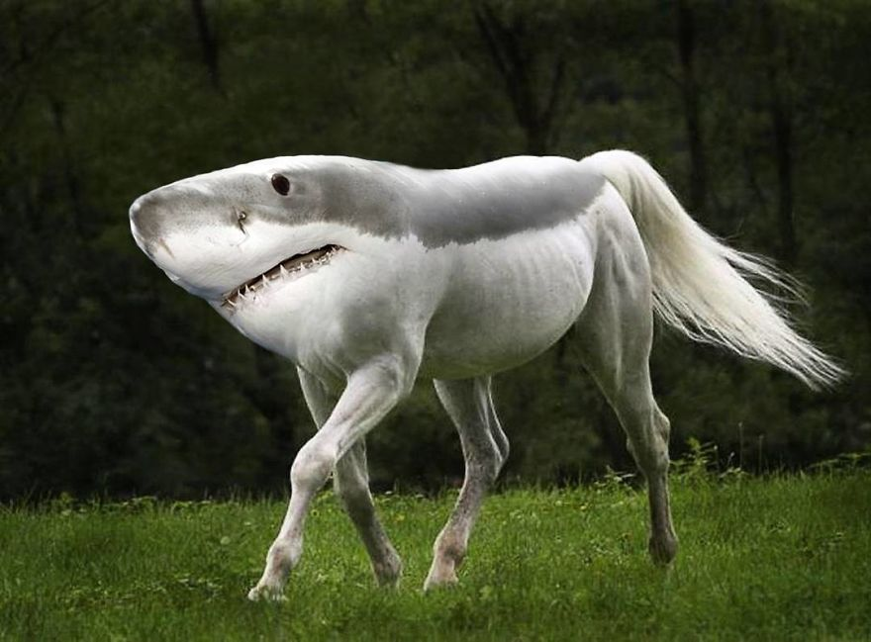

Slide 12
PATING

Slide 13
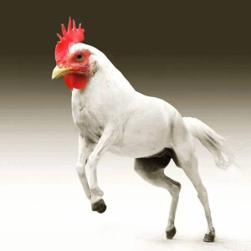

Slide 14
MANOK

Slide 15
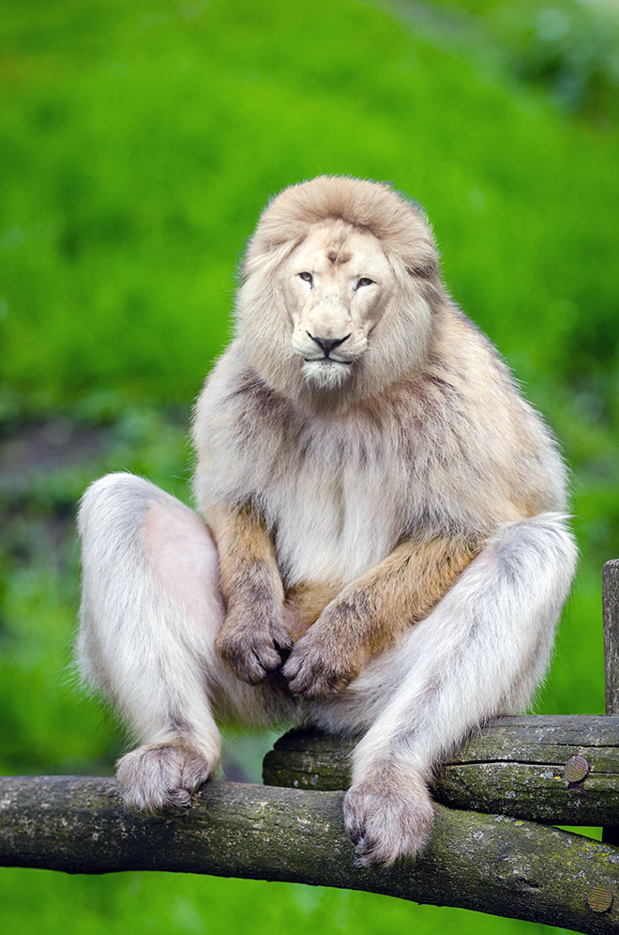

Slide 16
LION

Slide 17
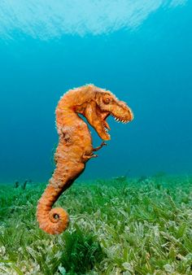

Slide 18
DINOSAUR

Slide 19
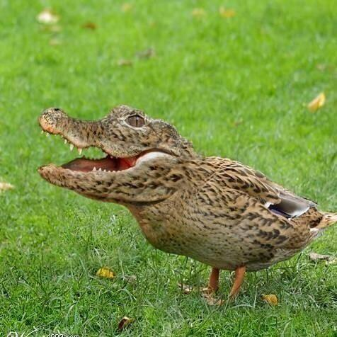

Slide 20
BUWAYA

Slide 21
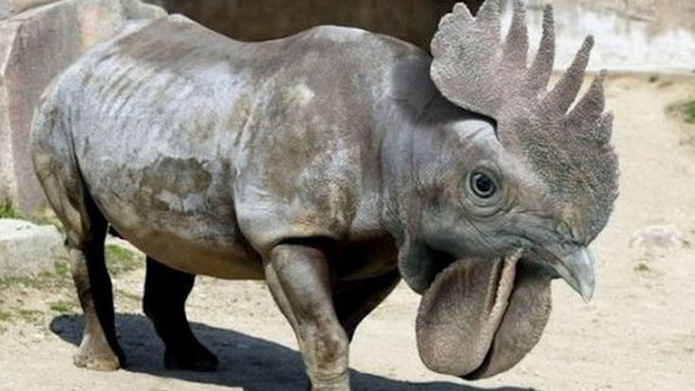

Slide 22
MANOK

Slide 23
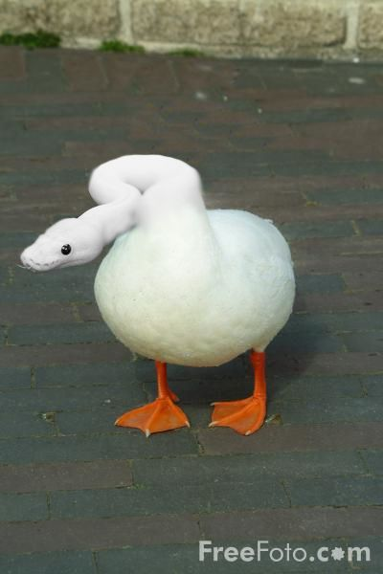

Slide 24
AHAS

Slide 25
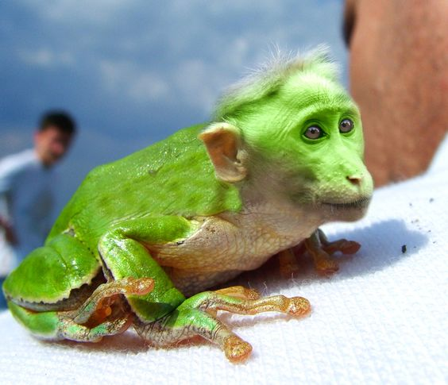

Slide 26
UNGGOY

Slide 27
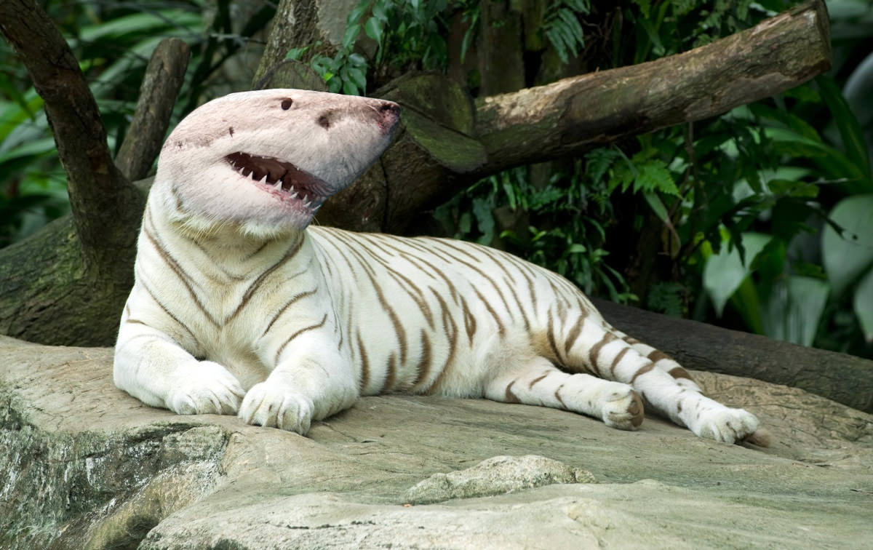

Slide 28
PATING

Slide 29
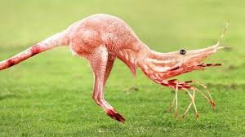

Slide 30
HIPON

Slide 31
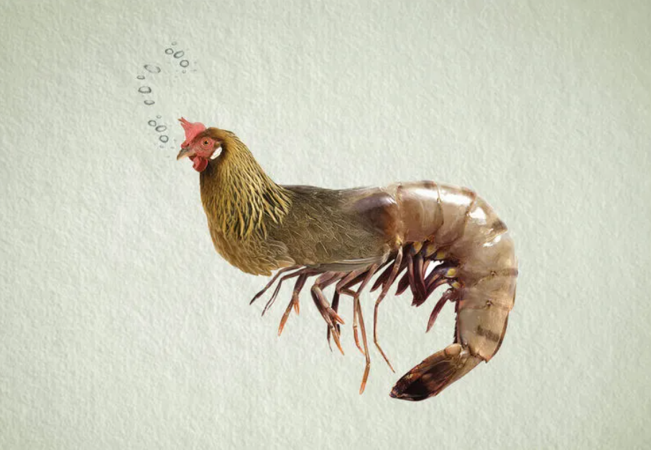

Slide 32
MANOK

Slide 33
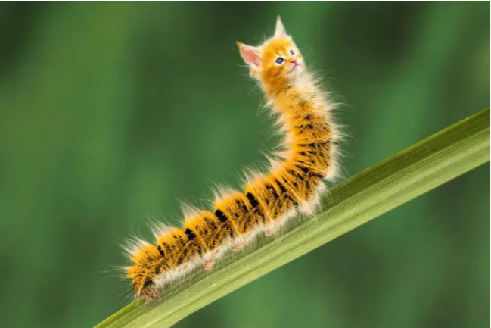

Slide 34
PUSA

